Slide 1
UNITED WAY OF BROOME COUNTY
1

Slide 2
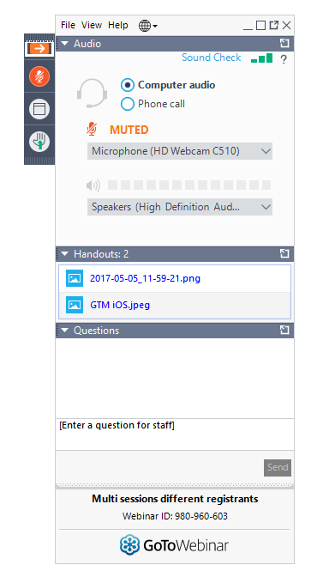
Can’t hear me? Make sure GoToWebinar has connected to your speakers and your volume is up. If that doesn’t work, exit the webinar and return. We’ll be here when you get back!
2

Slide 3
Questions? Type them here!
3

Slide 4
LOOKING BACK AND MOVING FORWARD
Presented by: LoriAnne Welch, Paula Perna, Maria Cataldo, and Lindsey Mott
November 10, 2020 11:00 am – 12:00 pm
4

Slide 5
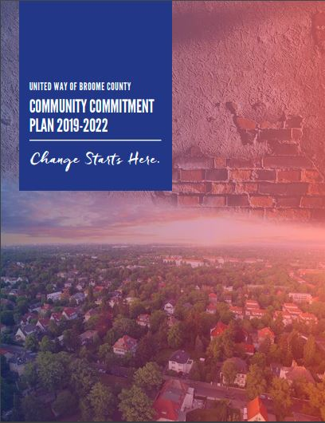
UNITED WAY OF BROOME COUNTY
Community Commitment Plan
The 2019-2022 Community Commitment Plan was created following our most recent Community Café Series. In it, we outline how we will achieve our mission and vision for Broome County by strategically leveraging the collective resources of community partners.
5
Notes:
LW

Slide 6
UNITED WAY OF BROOME COUNTY
Community Commitment Plan
Unify Efforts & Resources
Inspire Giving
Inspire Giving
Revitalize Collaboration
Based on community feedback, we will implement and invest in supportive service initiatives to broaden the capacity of community based organizations, so they can best leverage funding to address the most critical needs of the community.
6
Notes:
LW

Slide 7
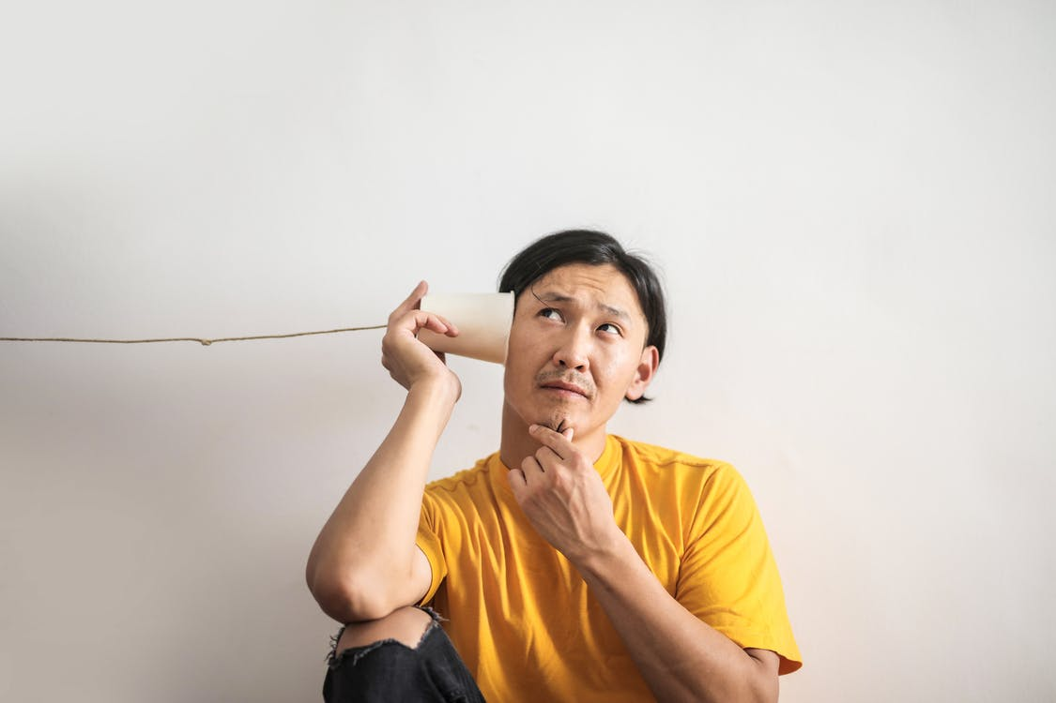
REVITALIZE COLLABORATION
CBO Survey
In May 2020, we sent a brief survey to staff at our funded partners to identify the needs and priorities of local organizations, and gain a stronger understanding of the services and supports that nonprofit organizations could use for improving their overall operations such as management and delivery of services to the community.
Here’s what you said…
7
Notes:
LM

Slide 8
CBO SURVEY RESULTS
Who did we hear from?
44%
88%
76%
100%
Response rate of individuals surveyed
Response rate of organizations surveyed
% of organizations that identified themselves as “Community-Based”
% of respondents who held and administrative role
8
Notes:
LM

Slide 9
CBO SURVEY RESULTS
What services can we provide?
MARKETING & ADVERTISING SUPPORT
VOLUNTEER RECRUITMENT AND RETENTION ASSISTANCE
55%
42%
PROGRAM EVALUATION & MEASUREMENT SUPPORT
VOLUNTEER MANAGEMENT SOFTWARE
45%
95%
53% were interested | 42% were somewhat interested
LEADERSHIP DEVELOPMENT RESOURCES
ACTIVE LEARNING GROUP FOR NONPROFIT PROFESSIONALS
42%
96%
45% were interested 51% were somewhat interested
9
Notes:
LM

Slide 10
CBO SURVEY RESULTS
How else can we collaborate?
NETWORKING OPPORTUNITIES
SHARED SERVICES & SPACE
CENTRALIZED NONPROFIT DATABASE
10
Notes:
LM

Slide 11
REVITALIZE COLLABORATION
Past Supportive Services
Sexual Harassment Training
Partnering for a Purpose 2019
Grant Fundamentals Workshop
CPR/AED
Developing a Safe Reopening Work Plan
11
Notes:
PP
Adding PFAP. Sexual Harassment, CPR, substance abuse – add from google sheet.**** Future DEI stuff. Looking forward – more supportive services described in survey

Slide 12
REVITALIZE COLLABORATION
Future Supportive Services
Partnering for a Purpose
DEI Resources
Quarterly Meetings Priority Area Meetings
Volunteer HQ
12
Notes:
PP

Slide 13
UNITED WAY OF BROOME COUNTY
Community Commitment Plan
Unify Efforts & Resources
Inspire Giving
Inspire Giving
Revitalize Collaboration
We will focus on ensuring the sustainable growth of fund development, impactful community projects and programs, and volunteer and engagement resources.
13
Notes:
LW

Slide 14
INSPIRE GIVING
Day of Action 2020
We collected 344 packages of items valued at $772.00 for 5 organizations.
14
Notes:
MC

Slide 15
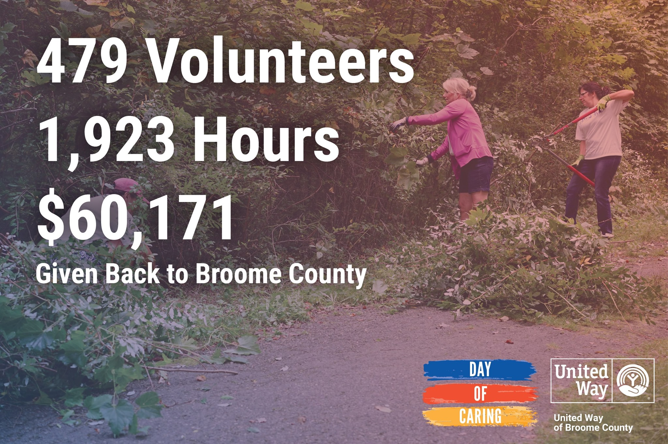
INSPIRE GIVING
Day of Caring 2020
15
15
Notes:
MC

Slide 16
INSPIRE GIVING
Day of Caring 2020
We collected over 1,300 packages valued at over $3,300 to 6 organizations.
16
Notes:
MC

Slide 17
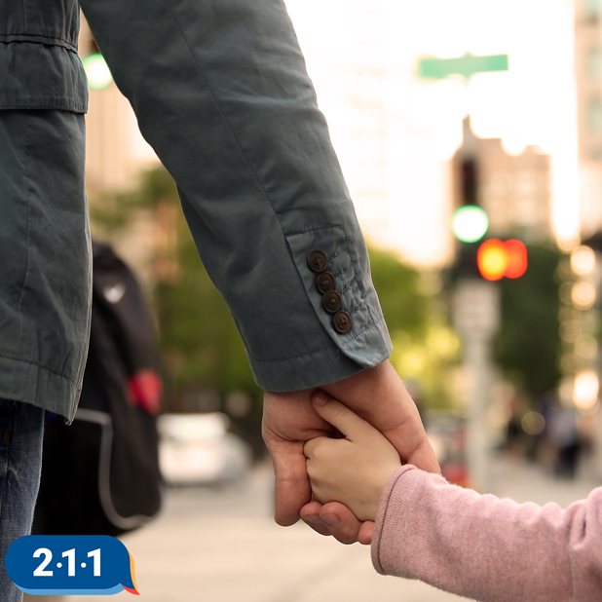
INSPIRE GIVING
Our 100% Promise
When you give, you intend for your gift to have a lasting positive impact in the community. To give you total confidence that your donation will make a direct impact, we promise to send 100% of your donation to make that positive change through community based projects and programs.
17
Notes:
MC

Slide 18
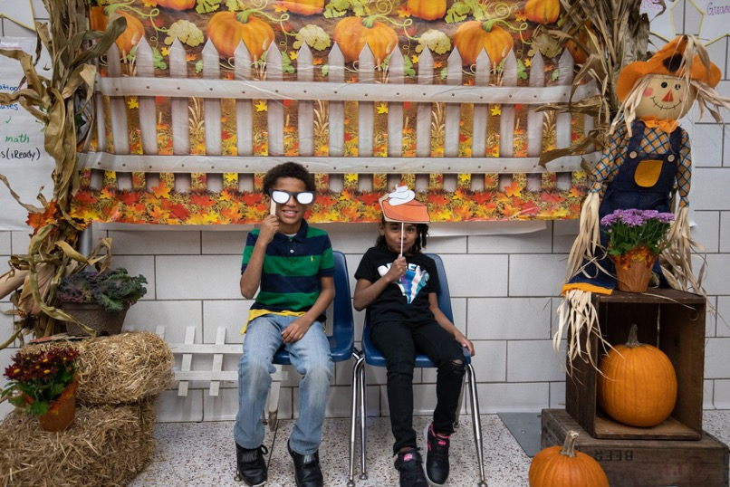
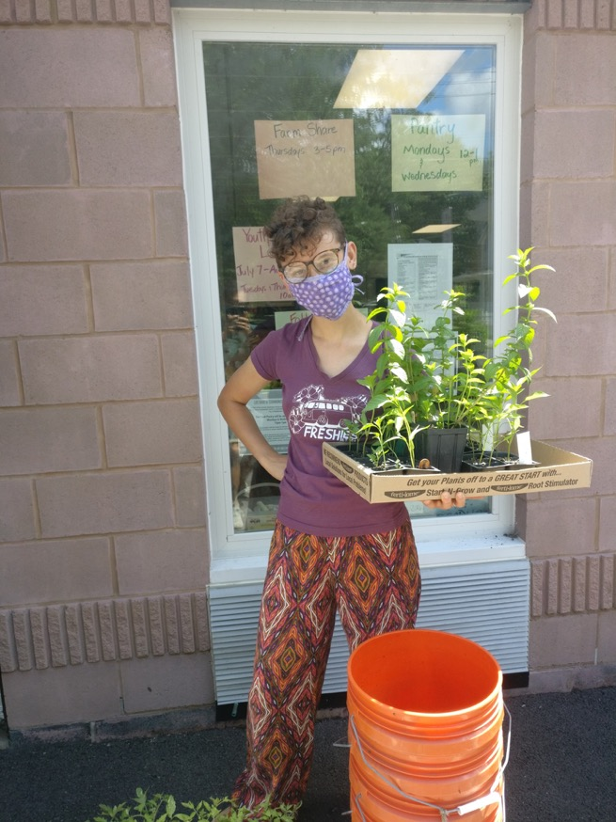
INSPIRE GIVING
Healthy Lifestyles Coalition
Planning is underway to replicate HLC programming, expanding services provided through collaborations with our partners to different communities in Broome County.
18
Notes:
PP

Slide 19
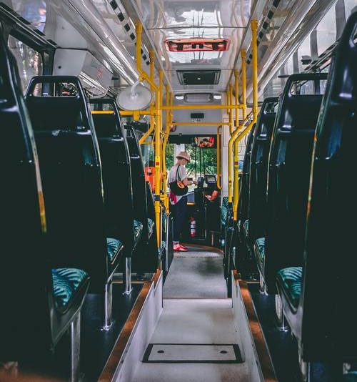
INSPIRE GIVING
Impact Tours
The first virtual impact tour of the Lee Barta Community Center will take place in early December. In the future, we hope to conduct impact tours using a bus to bring people from site to site.
19
Notes:
PP

Slide 20
INSPIRE GIVING
Mission United
Plan and implement Mission United Initiative, which will include participants within younger cohorts.
20
Notes:
PP

Slide 21
UNITED WAY OF BROOME COUNTY
Community Commitment Plan
Unify Efforts & Resources
Inspire Giving
Inspire Giving
We will build our capacity to connect individuals with community data, collaborate to provide training and development needs, and commit to a culture of diversity.
Revitalize Collaboration
21
Notes:
LW

Slide 22
UNIFY EFFORTS & RESOURCES
Volunteer HQ –
GalaxyDigital – Get Connected Overview
Volunteerism efforts are assisted through facilitation and involvement with other nonprofit agencies, corporate partners, volunteers, community groups, and affect change at the local level.
22
Notes:
MC

Slide 23
VOLUNTEER HQ
Core Features
Digital experience
Mobile-friendly
Enables CBOs to easily promote volunteer opportunities
Allows community members to browse existing needs
Builds a database of volunteers
Generates reports on all volunteer
Creates a volunteer resume
Provides a community calendar
Social media integration
Provides a customizable dashboard
23
Notes:
Digital experience
Mobile-friendly designed to drive volunteer & agency engagement
Enables CBOs to easily promote volunteer opportunities, in-kind needs, and special events using a familiar social environment
Allows community members to browse existing needs and registered for service opportunities that align with their passions
Builds a database of volunteers & provides tools to easily community and engage with volunteer in a targeted way
Generates reports on all volunteer data to capture useful info on the impact of volunteerism
Creates a volunteer resume that summaries each volunteer’s efforts within the community
Provides a community calendar that display events and needs
Social media integration of listed needs and volunteer responses to increase channels of communication
Provides a customizable dashboard that reflects our branding and features spotlights on specific content

Slide 24
VOLUNTEER HQ
Site Access
Accessing site as a Volunteer
Accessing site as a Agency
www.uwbroomevolunteers.org/
24
Notes:
MC

Slide 25
UNIFY EFFORTS & RESOURCES
Diversity, Equity, & Inclusion
On July 28, 2020, U.S. and International United Way’s approved a change to the United Way membership requirements. United Ways across the globe, including our own, are committed to the following actions:
- Develop, maintain, and publicly post an organization position opposing all forms of racism;
- Annually, provide racial equity training for all board members and staff; and - Develop and use racial equity as one of the criteria in making community investments.
25
Notes:
LW Highlight Korin’s new title?

Slide 26
DIVERSITY, EQUITY, & INCLUSION
Roundtables
Race, Racism & Social Justice (9/2)
Aggression: Macro, Micro, Violence (10/21)
Equity vs. Equality (11/10)
26
Notes:
MC

Slide 27
UNITED WAY OF BROOME COUNTY
COVID-19 RESPONSE
27
Notes:
LW

Slide 28
COVID-19 RESPONSE
COVID-19 Response Fund Alliance
.
28
Notes:
LW

Slide 29
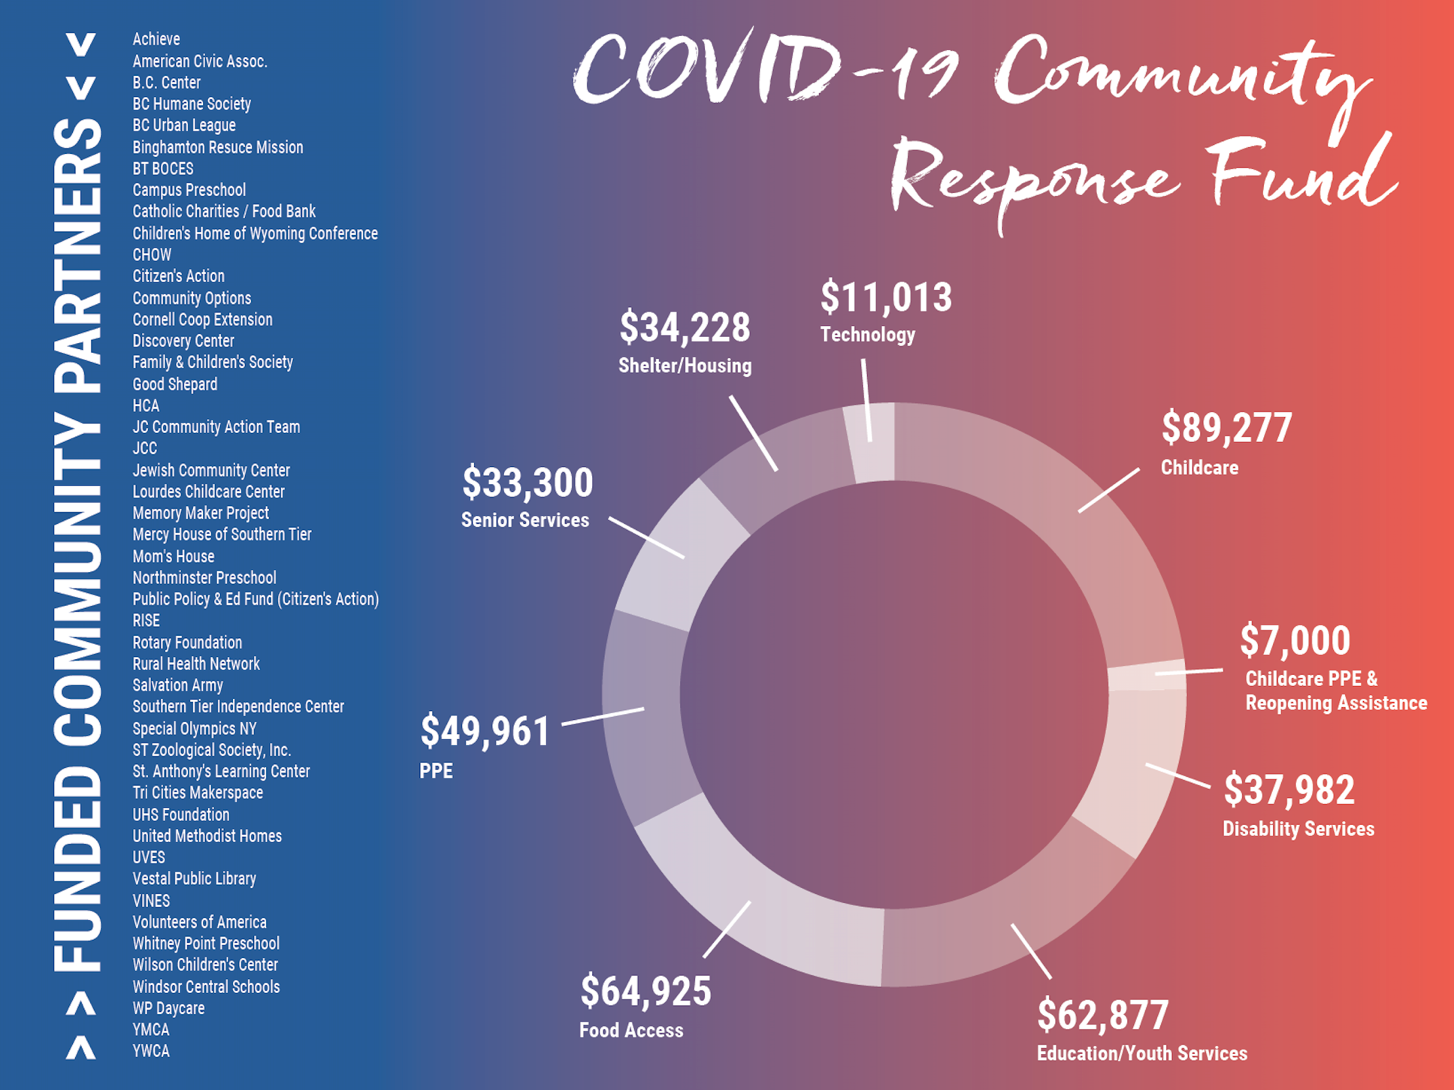
The COVID-19 Community Response Fund Alliance
United Way of Broome County
The Conrad and Virginia Klee Foundation
Community Foundation for South Central New York
The Dr. G. Clifford and Florence B. Decker Foundation
The Stewart W. and Willma C. Hoyt Foundation
George A. and Margaret Mee Charitable Foundation
Roger Kresge Foundation
57 Grants
$387,563
29
Notes:
LW

Slide 30
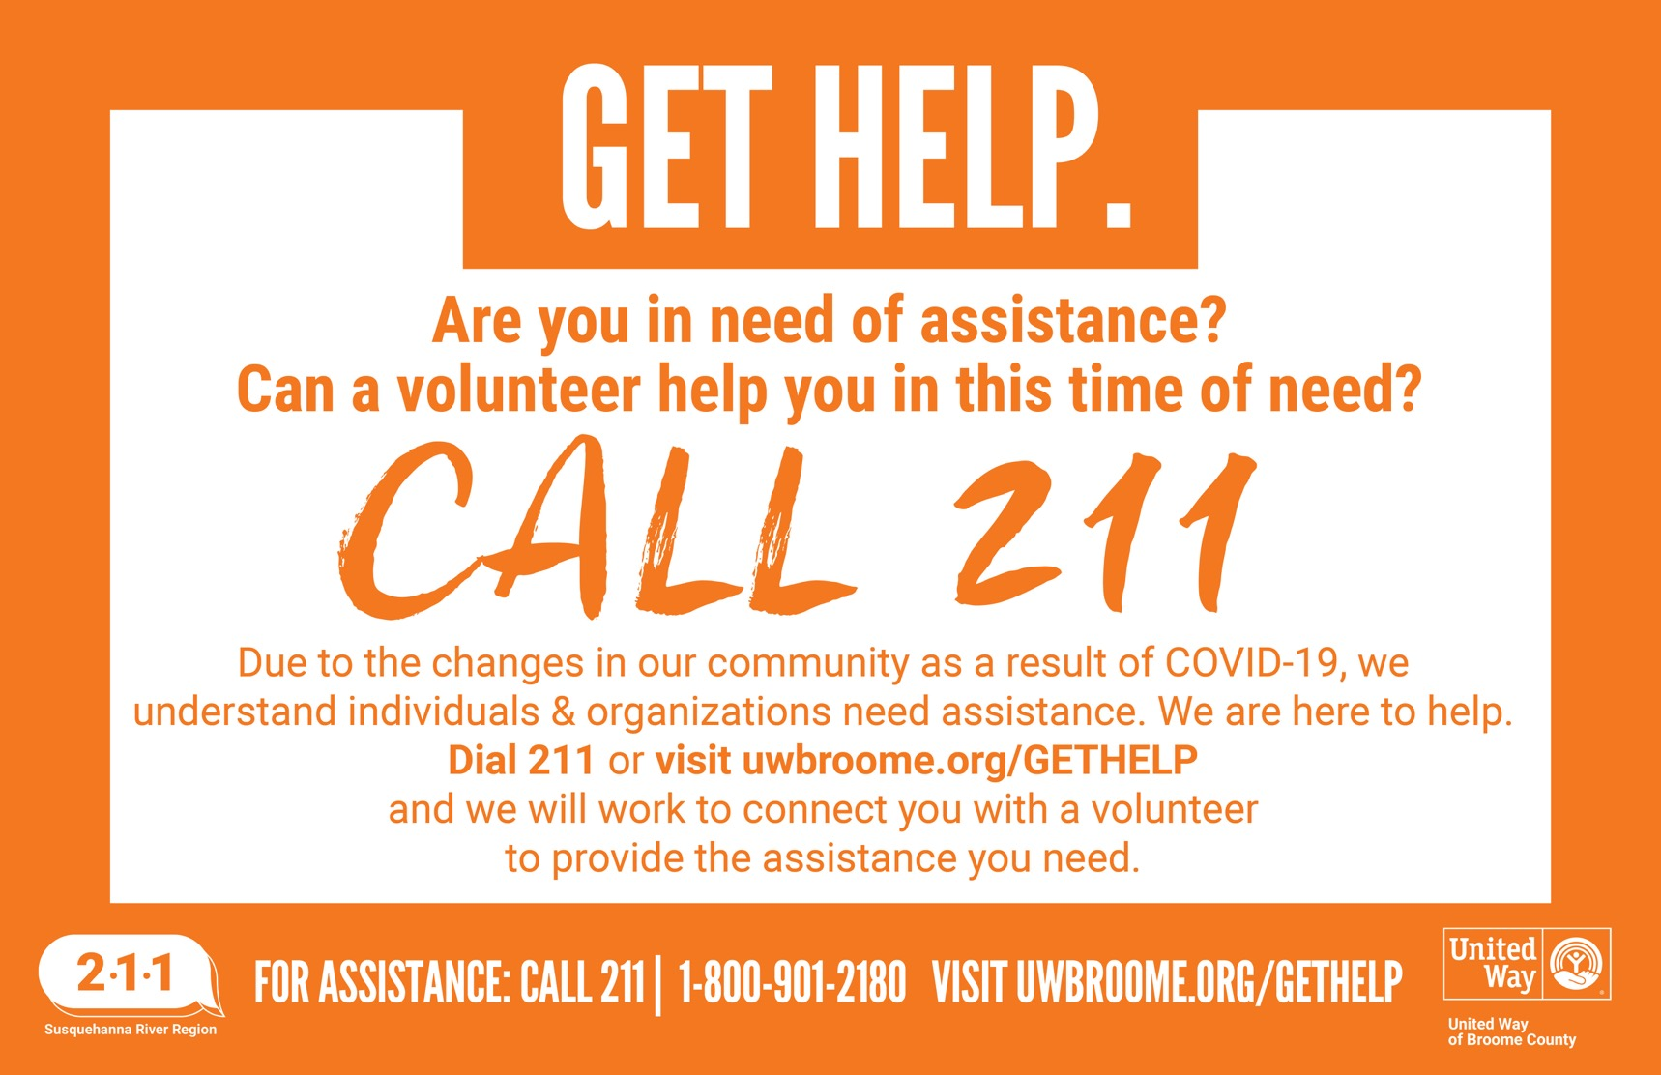
COVID-19 RESPONSE
GIVE HELP. GET HELP. Volunteer Initiative
30
30
Notes:
LW

Slide 31
COVID-19 RESPONSE
GIVE HELP. GET HELP. Volunteer Initiative
31
31
Notes:
MC

Slide 32
COVID-19 RESPONSE
GIVE HELP. GET HELP. Volunteer Initiative
170
388
1,488
OVER $43,000
VOLUNTEERS
INDIVIDUALS & ORGANIZATIONS
HOURS VOLUNTEERED
OF TIME DONATED
Matched to neighbors and organizations in need
Between March 20, 2020 and June 15, 2020
Based on valuation determined by Independent Sector
Had their needs met by volunteers
32
Notes:
MC

Slide 33
COVID-19 RESPONSE
Mask Distributions
OVER 5,000
OVER 7,000
8,863
97%
MASKS DONATED
MASKS DISTRIBUTED
REQUESTS
INCREASE IN CALL VOLUME
To United Way by Broome County residents, many of which were handmade
By United Way to Broome County residents and local organizations
Directly related to COVID-19 answers by Community Resource Specialists
Between March 15 to March 30, 2020, and the same period in 2019
33
Notes:
LW

Slide 34
UNITED WAY OF BROOME COUNTY
2021-2022 GRANT OPPORTUNTIES
34
Notes:
PP

Slide 35
GRANT OPPORTUNITIES
Strategic Community Priority Grants
November 2
November 17
November 20
December 7 - 11
January 15
Request for Proposals (RFP) released.
Information Session at 2 pm. United Way staff will walk through the RFP and answer questions from attendees.
Letters of Intent (LOIs) due at 3 pm.
Office Hours with United Way staff. Please register beforehand using the link included in the RFP.
Applications due at 3 pm.
35
Notes:
PP

Slide 36
GRANT OPPORTUNITIES
Capacity Building Grants
The Request for Proposals (RFP) for the 2021-2022 Capacity Building Grant Program will release in late January 2021.
36
Notes:
PP

Slide 37
Thank you!
Notes:
LW

